Slide 1
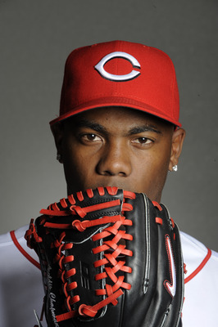
Aroldis Chapman

Slide 2
Albertin Aroldis Chapman de la Cruz
Born February 28,1988
Born and raised in Cuba
Chapman played for Holguin in the Cuban national series from 2006-2009
Chapman compiled a 24–19 record
365 strikeouts
He was used mainly as a starting pitcher, although he made 11 relief appearances in the 2007 season.

Slide 3
Aroldis Chapman’s MLb career
MLB pitcher for the Cincinnati Reds
Chapman bats and throws left handed
He is listed at 6’4” 195 pounds
As of August 2012, he holds the record for fastest recorded pitch speed in MLB history after throwing a 105.1 mph fastball in 2010

Slide 4
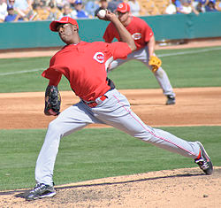
Photos

Slide 5
Video

