Slide 1
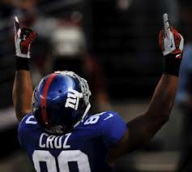
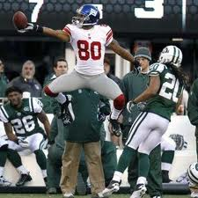
VICTOR CRUZ
BY:JIMMY WEGENER

Slide 2
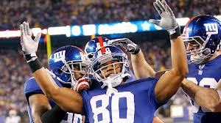
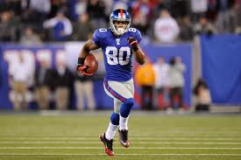
IN THE BEGINNING
Victor Cruz attended Paterson Catholic High School in Paterson, New Jersey where he was born to an African-American fireman father and a Puerto Rican mother. His parents never married and his father died in 2007.
COLLEGE
Cruz finished his career at UMASS with 131 catches ranking him fourth on the all-time UMass receptions list, despite the fact that he didn't start a game until his junior season. He scored 11 touchdowns in his career and had just under 2,000 receiving yards. Cruz was named a first-team All- Colonial Athletic Association wide receiver for the years 2008 and 2009

Slide 3
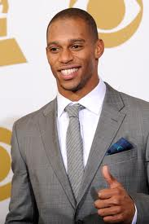
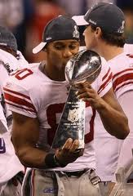
PROFESSIONAL CAREER
2010
Victor Cruz went undrafted in the 2010 NFL Draft and was signed by the New York Giants later in the
2010 season. He finished the preseason leading the NFL with 297 receiving yards, tied for the preseason lead with 4 touchdown catches and ranked second overall with 15 catches, and was chosen to be on the Giants' 53-man regular season roster. Cruz played in three games at the start of the season, without recording a catch before a hamstring injury placed him on injured reserve for the remainder of the year.

Slide 4
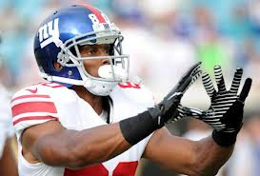
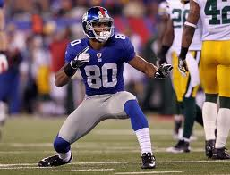
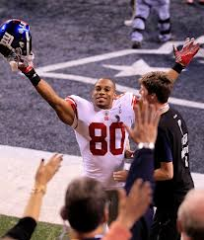
PROFESSIONAL CAREER
2011
In Week 17, in a do-or-die game against the Dallas Cowboys for the final playoff slot in the NFC, Cruz had 6 receptions for 178 yards, including the game's first score with a 74 yard touchdown catch. Cruz finished the season with a single season franchise record 1,536 receiving yards on 82 receptions and 9 touchdowns. Cruz was named a Second-team All- Pro by the Associated Press.
Against San Francisco in the NFC title game, Cruz had 10 grabs for 142 yards—all in the first half—as the Giants edged the 49ers, 20-17, in overtime to advance to Super Bowl XLVI. The Giants then won the Super Bowl against the Patriots for another Super Bowl title.

Slide 5
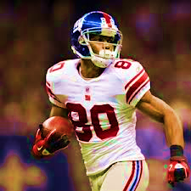
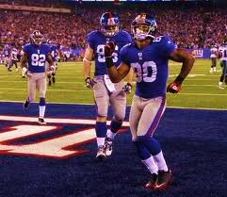
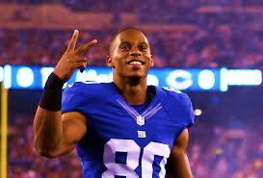

Slide 6
LONGEST TOUCHDOWN PASS IN THE NFL HISTORY
99 YARDS

Slide 7
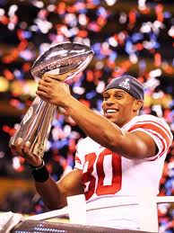
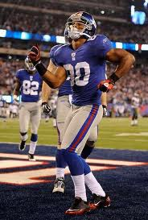
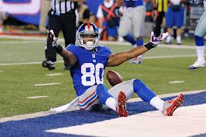
HISTORY BEHIND THE SALSA
Victor Cruz had learned how to salsa from his grandmother, Molina. Sadly, his grandmother passed away the Monday before the giants faced the Buccaneers. His trademark TD salsa dance that followed was less about celebration and more about honoring his grandma, the woman who had taught him to salsa years ago. Cruz did a few dance steps, then pointed skyward. “Right as I was done, I kind of looked up and held my hands up to her, letting her know that one was for her,” he said.
Ever since that day, Victor Cruz has celebrated every touchdown he gets with a little salsa. Cruz has celebrated nearly every touchdown with a salsa dance. The New York Daily News even had a dance instructor write about his technique. Cruz's touchdown dance led to him receiving an offer to appear on Dancing With The Stars, he turned down.

Slide 8
THE SALSA

